Slide 2
Notes:
Welcome the participants. Then introduce the topic.
Above all else, refer to the importance of taking care of yourself
Emphasize the message of caring for yourself and the community.

Slide 3
Notes:
Why are you interested in learning about كوفيد-١٩?
How has كوفيد-١٩ impacted you?
Do you consider yourself an essential worker?
If you return to work, when did you do it?
What do you think of the moment you returned to work?
Did your employer provide you with any necessary training to protect yourself when you returned to work?
Do you know what Personal Protective Equipment is?

Slide 4
Notes:
How do you feel about what you see in the pictures?

Slide 5
Notes:
In this training, we refer to the virus as SARS CoV-2 and the disease as كوفيد-١٩.
Coronaviruses are a large family of viruses that can cause illness in humans and animal species, including camels, cattle, cats, and bats. Unusually, the coronavirus from animals can pass on to people, and from there spread in between humans as has happened. The SARS-CoV-2 virus is a betacoronavirus, like MERS-CoV and SARS-CoV. These three viruses have their origin in bats.
The SARS CoV-2 virus is a new strain – a novel virus. Consequently, humans can become infected because they have not developed immunity against كوفيد-١٩. Immunity is acquired when humans have been previously exposed to or vaccinated against an infectious agent. An example is when people have measles in childhood or have been vaccinated, then they develop antibodies, a certain level of protection, immunity.
https://www.cdc.gov/coronavirus/2019-ncov/your-health/index.html

Slide 6
Notes:
كوفيد-١٩ COVID-19 is transmitted from person to person through close contact, especially by coughing or sneezing. It is also possible to become infected by speaking and breathing. Please note that virus particles are not visible to the naked eye. Most particles are submicron, less than a millionth of a meter.
The spread of SARS-CoV-2 or كوفيد-١٩ occurs in the same way that seasonal flu spreads. Influenza viruses are spread primarily from person to person by coughing or sneezing when they have the flu. We won't fully know how it's transmitted until scientists have had time to assess it.
Droplet transmission occurs when respiratory secretions from coughing, sneezing, or talking land on mucosal surfaces (nose, mouth, and eyes).
Contact transmission is touching something with كوفيد-١٩ virus on it and then touching your mouth, nose or eyes.
Aerosol transmission means breathing in infectious كوفيد-١٩ particles.

Slide 7
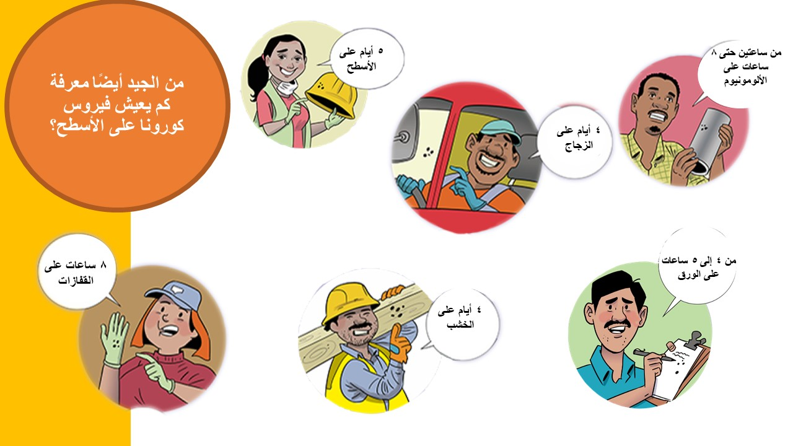
Notes:
How does the virus get on these surfaces?
How can we protect ourselves?

Slide 8
Notes:
Workers must be trained on the Chemical Safety Hazard Communication Standard.
Chlorine Bleach & Ammonia (dish liquids, window cleaners, many disinfectants) = Chlorine Gas (deadly)
Chlorine Bleach & Acids (toilet bowl cleaners, vinegar, many all-purpose cleaners) = Chlorine Gas (deadly)
Chlorine Bleach & Alcohol (enzyme cleaners, sanitizers) = Chloroform (toxic/pass out)
Source: http://www.howtocleanstuff.net/is-it-safe-to-mix-cleaning-products-with-bleach/

Slide 9
Notes:
The LWSC provides training in the language workers can understand.

Slide 11
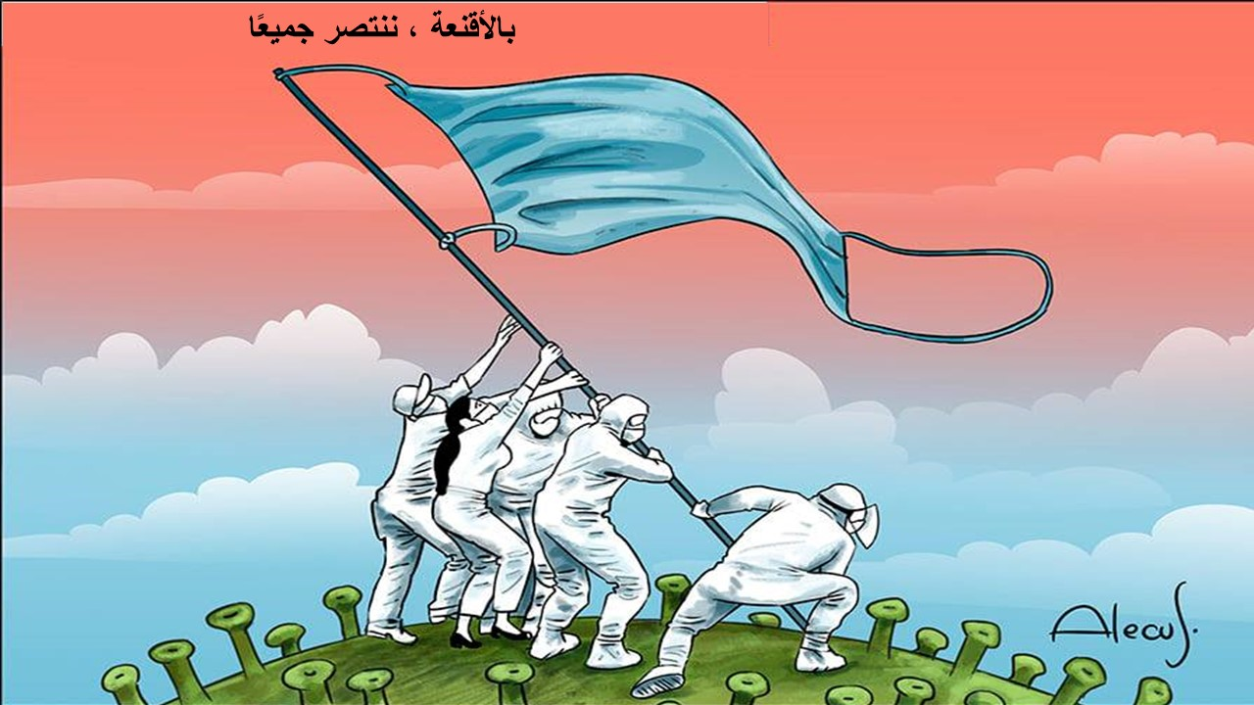
Notes:
How do we feel about wearing masks?

Slide 12
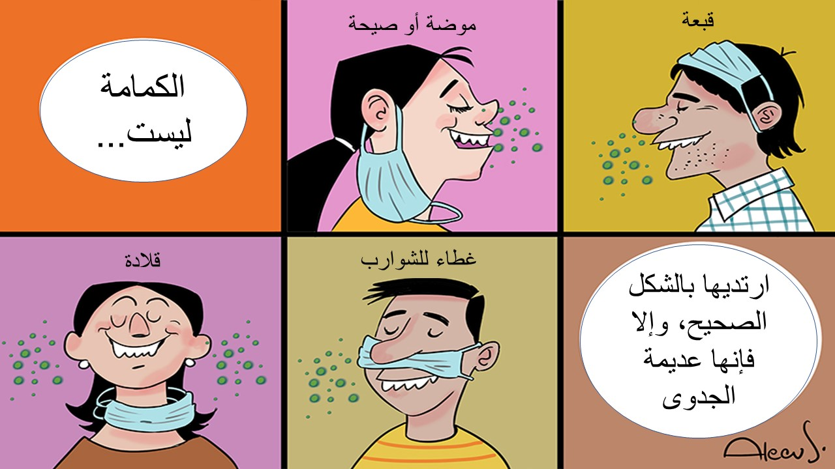
Notes:
What other wrong ways have you seen for wearing a mask?

Slide 13
Notes:
Dos
Wear a mask over your nose and mouth to help prevent getting and spreading COVID-19.
Wear a mask in public settings when around people who don’t live in your household, especially when indoors and when it may be difficult for you to stay six feet apart from people who don’t live with you.
Wear a mask correctly for maximum protection.
Wear your mask under your scarf, ski mask, or balaclava in cold weather
Keep a spare mask to replace one that becomes wet from moisture in your breath, snow, or rain.
Store wet reusable masks in a plastic bag until they can be washed.
Don’ts
Put the mask around your neck or up on your forehead.
Touch the mask, and, if you do, wash your hands or use hand sanitizer.

Slide 14
Notes:
You should wash it daily or after each use. It is very important to remove the mask correctly and wash your hands after touching a used mask.

Slide 15
Notes:
People who are physically near (within 6 feet) of a person with كوفيد-١٩ or have direct contact with that person are at greatest risk of infection.

Slide 16
Notes:
If you are sick with كوفيد-١٩ or think you might have كوفيد-١٩, follow these steps to care for yourself and to help protect other people in your home and community.
Stay home except to get medical care
Stay home. Most people with كوفيد-١٩ have mild illness and can recover at home without medical care. Do not leave your home, except to get medical care. Do not visit public areas.
Take care of yourself. Get rest and stay hydrated. Take over-the-counter medicines, such as acetaminophen, to help you feel better.
Stay in touch with your doctor. Call before you get medical care. Be sure to get care if you have trouble breathing, or have any other emergency warning signs, or if you think it is an emergency.
Avoid public transportation, ride-sharing, or taxis.
Separate yourself from other people
As much as possible, stay in a specific room and away from other people and pets in your home. If possible, you should use a separate bathroom. If you need to be around other people or animals in or outside of the home, wear a mask.
Tell your close contacts that they may have been exposed to كوفيد-١٩. An infected person can spread كوفيد-١٩ starting 48 hours (or 2 days) before the person has any symptoms or tests positive. By letting your close contacts know they may have been exposed to كوفيد-١٩, you are helping to protect everyone.
Additional guidance is available for those living in close quarters and shared housing - https://www.cdc.gov/coronavirus/2019-ncov/daily-life-coping/living-in-close-quarters.html
See كوفيد-١٩ and Animals if you have questions about pets - https://www.cdc.gov/coronavirus/2019-ncov/faq.html#Pets-and-Animals
If you are diagnosed with كوفيد-١٩, someone from the health department may call you. Answer the call to slow the spread.
https://www.cdc.gov/coronavirus/2019-ncov/if-you-are-sick/steps-when-sick.html

Slide 17
Notes:
When to seek emergency medical attention
Look for emergency warning signs* for COVID-19. If someone is showing any of these signs, seek emergency medical care immediately:
Trouble breathing
Persistent pain or pressure in the chest
New confusion
Inability to wake or stay awake
Bluish lips or face
*This list is not all possible symptoms. Please call your medical provider for any other symptoms that are severe or concerning to you.
Call 911 or call ahead to your local emergency facility: Notify the operator that you are seeking care for someone who has or may have COVID-19.
https://www.cdc.gov/coronavirus/2019-ncov/if-you-are-sick/steps-when-sick.html

Slide 18
Notes:
Most estimates of the incubation period for كوفيد-١٩ fluctuate from 1 to 14 days, usually around five days. The "incubation period" means the time between contracting the virus and starting to have symptoms of the disease.

Slide 19
Notes:
If there is an outbreak of COVID-19 in your community, it could last quite a while. (An outbreak is when a large number of people suddenly get sick.) Depending on the severity of the outbreak, public health officials may recommend community actions to reduce people's risk of exposure to COVID-19. These actions can slow down the rate of spread and reduce the impact of the disease. If you are at increased risk of acquiring COVID-19 at a severe level because of your age or because you have a serious health problem for a long time, it is extremely important that you take action to reduce your risk of getting sick. Severe illness from COVID-19 is defined as hospitalization, admission to the ICU, intubation or mechanical ventilation, or death.
Adults of any age with the following conditions are at increased risk of severe illness from the virus that causes COVID-19:
Cancer
Chronic kidney disease
COPD (chronic obstructive pulmonary disease)
Down Syndrome
Heart conditions, such as heart failure, coronary artery disease, or cardiomyopathies
Immunocompromised state (weakened immune system) from solid organ transplant
Obesity (body mass index [BMI] of 30 kg/m² or higher but < 40 kg/m²)
Severe Obesity (BMI ≥ 40 kg/m²)
Pregnancy
Sickle cell disease
Smoking
Type 2 diabetes mellitus
COVID-19 is a new disease. Currently there are limited data and information about the impact of many underlying medical conditions on the risk for severe illness from COVID-19. Based on what we know at this time, adults of any age with the following conditions might be at an increased risk for severe illness from the virus that causes COVID-19:
Asthma (moderate-to-severe)
Cerebrovascular disease (affects blood vessels and blood supply to the brain)
Cystic fibrosis
Hypertension or high blood pressure
Immunocompromised state (weakened immune system) from blood or bone marrow transplant, immune deficiencies, HIV, use of corticosteroids, or use of other immune weakening medicines
Neurologic conditions, such as dementia
Liver disease
Overweight (BMI > 25 kg/m², but < 30 kg/m²)
Pulmonary fibrosis (having damaged or scarred lung tissues)
Thalassemia (a type of blood disorder)
Type 1 diabetes mellitus
We are learning more about COVID-19 every day. The list here of underlying medical conditions that increases risk of severe COVID-19 illness is not exhaustive and only includes conditions with sufficient evidence to draw conclusions; it is a living document that may be updated at any time, subject to potentially rapid change as the science evolves.
For the most recent updated list of “medical conditions” that put people at increased risk of severe illness:
https://www.cdc.gov/coronavirus/2019-ncov/need-extra-precautions/people-with-medical-conditions.html?CDC_AA_refVal=https%3A%2F%2Fwww.cdc.gov%2Fcoronavirus%2F2019-ncov%2Fneed-extra-precautions%2Fgroups-at-higher-risk.html

Slide 20
Notes:
Explain that the body defends itself but must be helped.

Slide 21
Notes:
There's a lot you don't know about كوفيد-١٩. What's true today could change in the coming months. However, that does not mean that reasonable and effective steps cannot or should not be taken now to prepare and protect workers. It is preferable to use excessive caution to avoid disease and death.

Slide 22
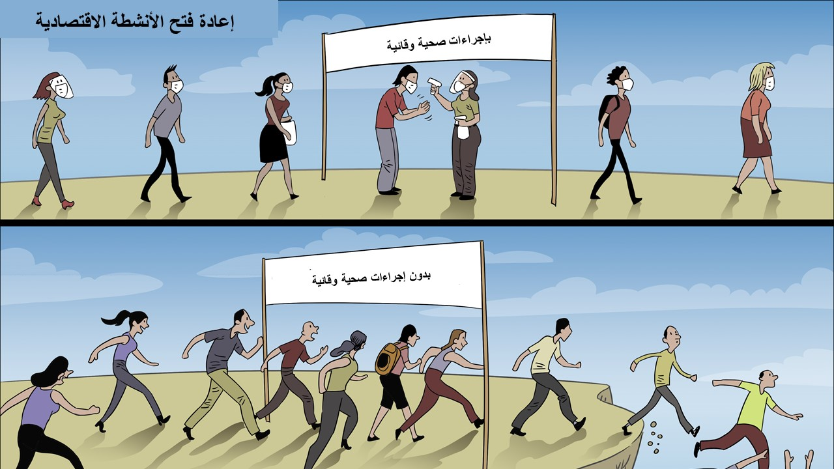
Notes:
How do we feel about safety precautions?

Slide 23
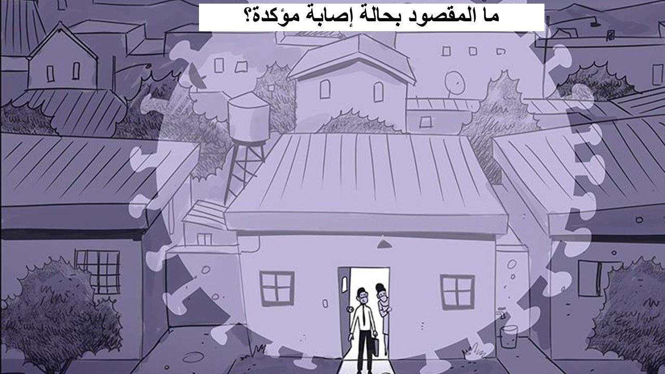
Notes:
A confirmed case is an individual who had a confirmatory viral test performed by way of a throat swab, nose swab or saliva test and that specimen tested positive for SARS-CoV-2, which is the virus that causes COVID-19.
After confirmation, contacts are traced to inform people that they may have been exposed to coronavirus by an infected person.
The CDC and Illinois consider both a confirmed case and a probable case in making decisions about isolation, quarantine and contact tracing.
As mentioned above, a confirmed case is laboratory confirmed via molecular test while a probable case meets clinical criteria AND is epidemiologically linked, or has a positive antigen test.
For Illinois guidance see: https://www.dph.illinois.gov/covid19/community-guidance/isolation-quarantine

Slide 24
Notes:
This is a good visual graph of a كوفيد-١٩ case scenario and what to do if a person gets infected with كوفيد-١٩.
Question? - If your employee began showing symptoms for كوفيد-١٩ on May 10, and then tested positive for كوفيد-١٩ on May 12, when can you assume that your infectious period began? (ANSWER: Around May 7 or May 8)
Image Source:
https://theconversation.com/how-long-are-you-infectious-when-you-have-coronavirus-135295

Slide 25
Notes:
Similarities: COVID-19 and influenza viruses have a similar disease presentation. Both viruses are transmitted by contact, droplets, and fomites.
https://www.cdc.gov/flu/symptoms/flu-vs-covid19.htm
Don’t forget to get your flu vaccine during flu season.

Slide 26
Notes:
Regardless of the potential for exposure, there are several steps we can all take to decrease the chances of getting sick or spreading كوفيد-١٩ at work.

Slide 27
Notes:
Any area of work can be a focus of risk and contagion if you do not have hierarchy of control protocols and a program of good sanitization practices as well as a process at the change of each shift or whenever necessary.
How can you determine if your risk of acquiring كوفيد-١٩ is higher where you work than in the general population?
Does the work environment require close contact with people potentially infected with the كوفيد-١٩ virus?
Do job-specific obligations require close, repeated or prolonged contact with people known or suspected to have the كوفيد-١٩ virus?
Has the spread of the virus in your community included workplace cases?

Slide 28
Notes:
Explain the hierarchy of controls

Slide 29
Notes:
Planning and preparation for كوفيد-١٩ should be integrated into existing health and safety systems and emergency plans. Elements of an effective program include those mentioned above (among many others).
Maintain flexibility so that the plan for كوفيد-١٩ can be modified. Evaluation and improvement of the system refers to the organization's policies and procedures relevant to the plan for كوفيد-١٩ in the workplace. Family preparation is vital to ensure healthy staff are available and prepared to work during a pandemic. Organizations should seek to identify and evaluate how the closure of schools/day care centers/older adult care centers and other employee needs could have an impact on employee availability during a pandemic.
http://nap.edu/22414
https://www.cdc.gov/coronavirus/2019-ncov/community/guidance-business-response.html?CDC_AA_refVal=https%3A%2F%2Fwww.cdc.gov%2Fcoronavirus%2F2019-ncov%2Fspecific-groups%2Fguidance-business-response.html

Slide 31
Notes:
Each state has its own workers' compensation law. This could be relevant if a worker is exposed to SARS CoV-2 and becomes ill at work.

Slide 33
Notes:
In Illinois, Workers' Compensation rights apply when you get كوفيد-١٩ and are working.
If there is evidence that Covid 19 hit you in your workplace, contact the Collaborative and we can recommend a lawyer who works these cases.

Slide 34
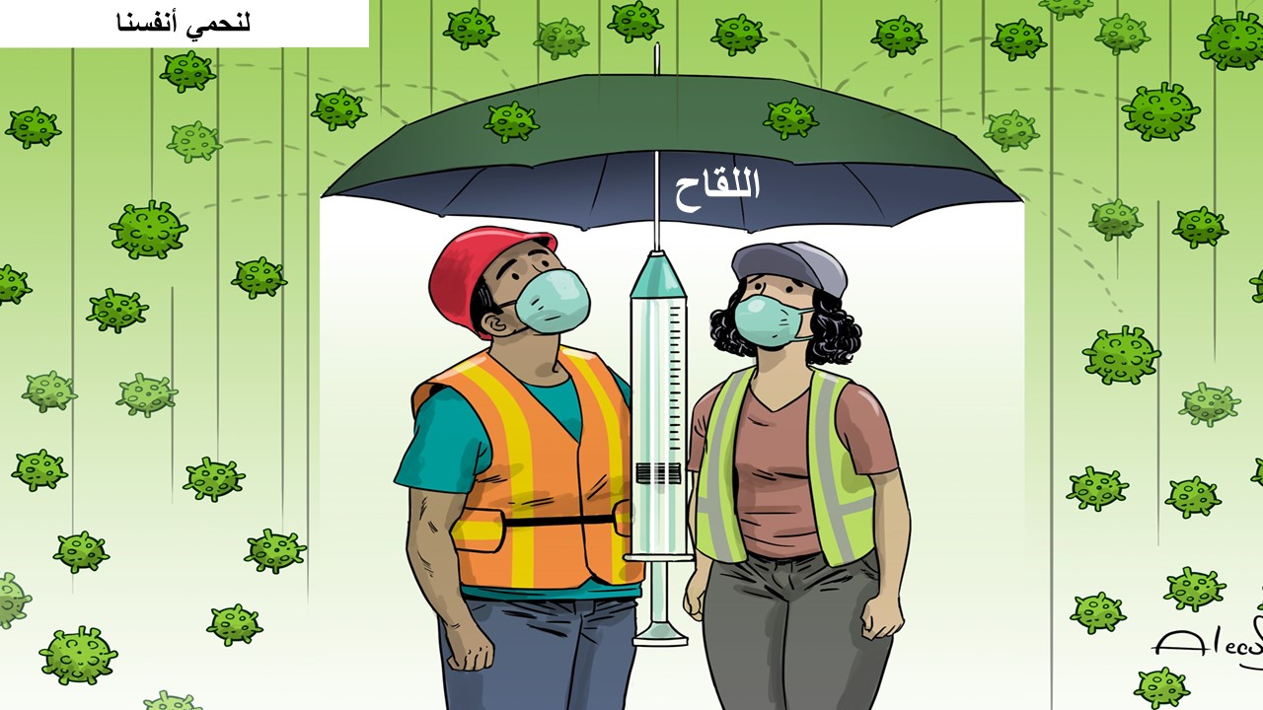
Notes:
Benefits of getting vaccinated against COVID-19.
We understand that some people may be concerned about getting vaccinated now that COVID-19 vaccines are available in the United States. While more COVID-19 vaccines are being developed as quickly as possible, routine processes and procedures remain in place to ensure the safety of any vaccine that is authorized or approved for use. Safety is a top priority, and there are many reasons to get vaccinated.
Can a COVID-19 vaccine make me sick with COVID-19?
No. None of the COVID-19 vaccines contain the live virus that causes COVID-19 so a COVID-19 vaccine cannot make you sick with COVID-19. Facts about COVID-19 Vaccines
COVID-19 vaccination will help keep you from getting COVID-19
All COVID-19 vaccines currently available in the United States have been shown to be highly effective at preventing COVID-19. Learn more about the different COVID-19 vaccines.
All COVID-19 vaccines that are in development are being carefully evaluated in clinical trials and will be authorized or approved only if they make it substantially less likely you’ll get COVID-19. Learn more about how federal partners are ensuring COVID-19 vaccines work.
Based on what we know about vaccines for other diseases and early data from clinical trials, experts believe that getting a COVID-19 vaccine may also help keep you from getting seriously ill even if you do get COVID-19.
Getting vaccinated yourself may also protect people around you, particularly people at increased risk for severe illness from COVID-19.
Experts continue to conduct more studies about the effect of COVID-19 vaccination on severity of illness from COVID-19, as well as its ability to keep people from spreading the virus that causes COVID-19.
COVID-19 vaccination is a safer way to help build protection
COVID-19 can have serious, life-threatening complications, and there is no way to know how COVID-19 will affect you. And if you get sick, you could spread the disease to friends, family, and others around you.
Clinical trials of all vaccines must first show they are safe and effective before any vaccine can be authorized or approved for use, including COVID-19 vaccines. The known and potential benefits of a COVID-19 vaccine must outweigh the known and potential risks of the vaccine for use under what is known as an Emergency Use Authorization (EUA). Watch a video on what an EUA is.
Getting COVID-19 may offer some natural protection, known as immunity. Current evidence suggests that reinfection with the virus that causes COVID-19 is uncommon in the 90 days after initial infection. However, experts don’t know for sure how long this protection lasts, and the risk of severe illness and death from COVID-19 far outweighs any benefits of natural immunity. COVID-19 vaccination will help protect you by creating an antibody (immune system) response without having to experience sickness.
Both natural immunity and immunity produced by a vaccine are important parts of COVID-19 disease that experts are trying to learn more about, and CDC will keep the public informed as new evidence becomes available.
COVID-19 vaccination will be an important tool to help stop the pandemic
Wearing masks and social distancing help reduce your chance of being exposed to the virus or spreading it to others, but these measures are not enough. Vaccines will work with your immune system so it will be ready to fight the virus if you are exposed.
The combination of getting vaccinated and following CDC’s recommendations to protect yourself and others will offer the best protection from COVID-19.
Stopping a pandemic requires using all the tools we have available. As experts learn more about how COVID-19 vaccination may help reduce spread of the disease in communities, CDC will continue to update the recommendations to protect communities using the latest science.
FOR THE LATEST UPDATES SEE: https://www.cdc.gov/coronavirus/2019-ncov/vaccines/vaccine-benefits.html?CDC_AA_refVal=https%3A%2F%2Fwww.cdc.gov%2Fcoronavirus%2F2019-ncov%2Fvaccines%2Fabout-vaccines%2Fvaccine-benefits.html

Slide 35
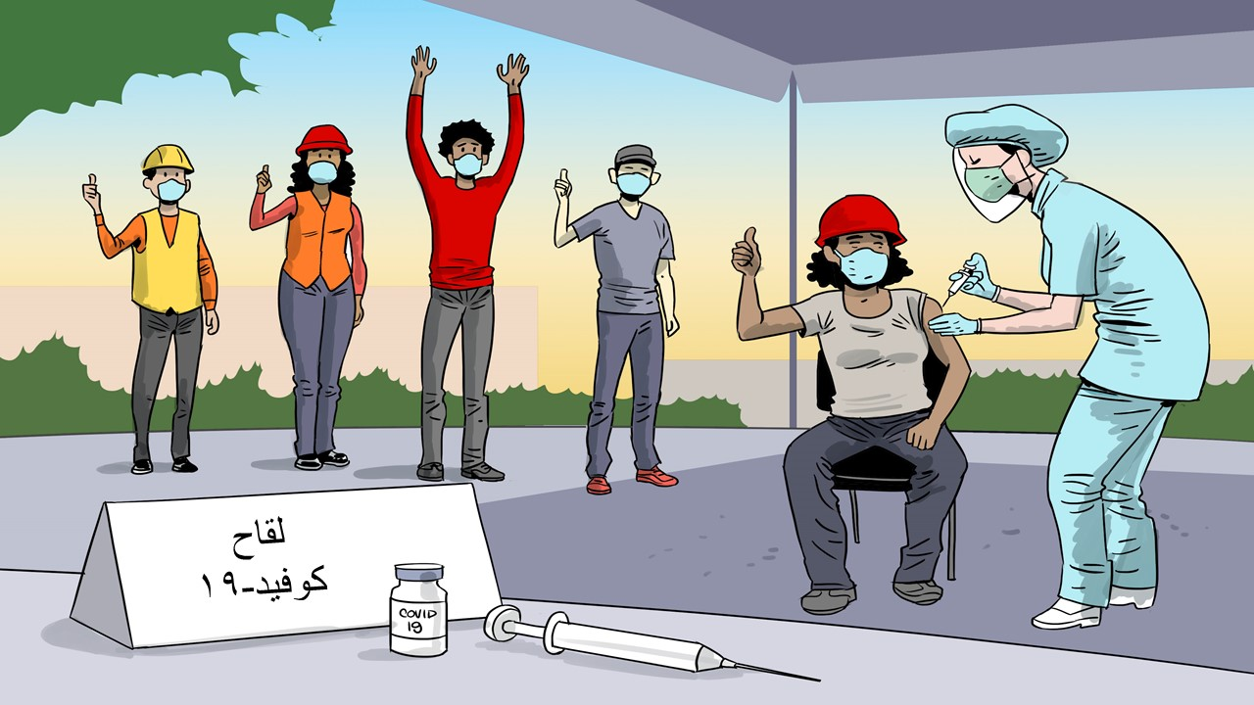
Notes:
What to expect after receiving the كوفيد-١٩ vaccine?
كوفيد-١٩ vaccination will help protect you from getting كوفيد-١٩. You may experience side effects, which are normal signs that your body is generating protection. These side effects can affect your ability to do your daily activities, but they should go away within a few days.
Most common side effects
In the arm where you received the injectable vaccine:
Pain
Swelling
On the rest of the body:
Fever
Chills
Tiredness
Headache
Useful tips
If you feel pain or have any discomfort, talk to your doctor about taking over-the-counter medications, such as ibuprofen or acetaminophen.
To reduce the pain and discomfort where you received the injectable vaccine:
Apply a clean, cold, damp cloth over the area.
Use or exercise your arm.
To reduce fever discomfort:
Drink plenty of fluids.
Wear light clothing.
When to call your doctor
In most cases, it's normal to feel pain or discomfort from fever. Contact your doctor or health care provider:
If the redness or sensitivity where you received the injectable vaccine increases after 24 hours
If your side effects worry you or don't seem to be disappearing after a few days
Remember
Side effects may be similar to flu symptoms and even affect your ability to do your daily activities, but they should go away within a few days.
With most كوفيد-١٩ vaccines, you'll need 2 injections to make them work. Apply the second injection even if you experience side effects after the first application, unless your vaccination provider or doctor tells you not to take the second injection.
Your body needs time to generate protection after any vaccine is given. كوفيد-١٩ vaccines that require 2 injections may not protect you until a week or two after the second injection is given.
XXXXXXXXXXXXX UPDATED NOTES
ALL Instructors should go through the following sources prior to talking about vaccines:
1) https://www.chop.edu/centers-programs/vaccine-education-center/making-vaccines/prevent-covid
2) https://www.cdc.gov/coronavirus/2019-ncov/vaccines/faq.html
How many shots of COVID-19 will be needed?
The current available vaccines to prevent COVID-19 in the United States will require two shots to be effective. After you receive the first shot, you will need to come back during a specific date or range of dates to get the second shot. Shots should be of the same vaccine. So if you received the Pfizer vaccine the first time, you should receive the Pfizer vaccine the second time.
There is one COVID-19 vaccine in the pipeline in Phase 3 clinical trials in the United States that uses one shot, but all currently available and most vaccines in clinical trials require two shots.
Will the shots be free?
Yes
If I already had COVID-19 and recovered, do I still need to get vaccinated with COVID-19 when it is available?
COVID-19 vaccination should be offered to you regardless of whether you already had COVID-19 infection. You should not be required to have an antibody test before you are vaccinated.
However, anyone currently infected with COVID-19 should wait to get vaccinated until after their illness has resolved and after they have met the criteria to discontinue isolation.
Additionally, current evidence suggests that reinfection with the virus that causes COVID-19 is uncommon in the 90 days after initial infection. Therefore, people with a recent infection may delay vaccination until the end of that 90-day period if desired.
Who can get the COVID-19 vaccine?
Most people are able to get the COVID-19 vaccine, once supplies allow for their priority group to be vaccinated. But, a few groups of people should not get the vaccine, and some others should consult with their doctor or follow special procedures.
People who should NOT get the COVID-19 vaccine
Anyone with a previous severe or immediate allergic reaction (i.e., one that causes anaphylaxis or requires medical intervention) to a COVID-19 mRNA vaccine dose, a vaccine component, or polysorbate
Those younger than 16 years of age
People currently isolating or experiencing symptoms of COVID-19; these people can get vaccinated once they are finished isolation and their primary symptoms have resolved.
People who may get the vaccine after considering risks and benefits and/or consulting with their healthcare provider
Individuals with a history of severe or immediate allergic reaction to any vaccine or injectable medication (These individuals should be observed for 30 minutes after receipt of the vaccine.)
Pregnant women
People with certain immune-compromising conditions
Breastfeeding women
People on anticoagulants
People who should follow special procedures
Someone with a history of severe or immediate allergic reaction (requiring medical intervention) to anything other than a vaccine or injectable medication can get the vaccine, but they should remain at the vaccination location for medical observation for 30 minutes after receipt of the vaccine.
Pregnant women who develop a fever after vaccination should take acetaminophen. (See more in the pregnancy-related questions lower on this page.)
People who recently had COVID-19 and were treated with antibody-based therapies (e.g., monoclonal antibodies or convalescent plasma) should wait until 90 days after treatment to be vaccinated.
People with a known COVID-19 exposure should wait until their quarantine is over before getting vaccinated (unless they live in a group setting, such as a nursing home, correctional facility, or homeless shelter, in which case they can be vaccinated during the quarantine period).
People who got another vaccine (non-COVID-19 vaccine) should wait at least 14 days before getting COVID-19 vaccine. Likewise, if a person got the COVID-19 vaccine, they should wait at least 14 days before getting any other vaccines (non-COVID-19 vaccines).
Should I wear a mask when I go to get vaccinated?
Yes, be sure to wear a mask. CDC recommends that during the pandemic people wear a mask that covers their nose and mouth when in contact with others outside your household, when in healthcare facilities, and when receiving any vaccine, including a COVID-19 vaccine. Anyone who has trouble breathing or is unable to remove a mask without assistance should not wear a mask. For more information, visit considerations for wearing masks.
What to expect after receiving the COVID-19 vaccine?
COVID-19 vaccination will help protect you from getting sick from COVID-19. You may experience side effects, which are normal signs that your body is generating protection. These side effects can affect your ability to do your daily activities, but they should go away within a few days.
Most common side effects
In the arm where you received the injectable vaccine:
Pain
Swelling
On the rest of the body:
Fever
Chills
Tiredness
Headache
Useful tips
If you feel pain or have any discomfort, talk to your doctor about taking over-the-counter medications, such as ibuprofen or acetaminophen.
To reduce the pain and discomfort where you received the injectable vaccine:
Apply a clean, cold, damp cloth over the area.
Use or exercise your arm.
To reduce fever discomfort:
Drink plenty of fluids.
Wear light clothing.
When to call your doctor
In most cases, it's normal to feel pain or discomfort from fever. Contact your doctor or health care provider:
If the redness or sensitivity where you received the injectable vaccine increases after 24 hours
If your side effects worry you or don't seem to be disappearing after a few days
Remember
Side effects may be similar to flu symptoms and even affect your ability to do your daily activities, but they should go away within a few days.
With most COVID-19 vaccines, you'll need 2 injections to make them work. Apply the second injection even if you experience side effects after the first application, unless your vaccination provider or doctor tells you not to take the second injection.
Your body needs time to generate protection after any vaccine is given. COVID-19 vaccines that require 2 injections may not protect you until a week or two after the second injection is given.
It is important that we all continue to use all available tools to help stop this pandemic as we learn more about how COVID-19 vaccines work in real-world conditions. Cover your mouth and nose with a mask while you're with others, stay at least 6 feet away from others, avoid crowds, and wash your hands often.
https://www.cdc.gov/coronavirus/2019-ncov/vaccines/faq.html

