Slide 1
Notes:
Welcome!
Introductions:
Name
Trade
Position
Years in construction
Most of the slides we’ll be going over are in your student handout starting on page 4. You can follow along and take notes.

Slide 2
Session 1
Welcome, introductions, goals & learning objectives
Characteristics of ineffective and effective leaders
Importance and benefits of effective safety leadership
Introduce safety leadership skills
Notes:
Today we will be going over:
Goals & learning objectives for the session
The definition of a safety leader
Characteristics of ineffective and effective leaders
The importance and benefits of effective safety leadership
Finally, I’ll introduce the safety leadership skills that we will be discussing throughout this course

Slide 3
Goal
Introduce you to critical safety leadership skills you can use to improve safety climate and safety outcomes on the job site.
Notes:
The overall goal of this training is to give you the opportunity to learn and enhance some critical safety leadership skills that you can use to improve the safety climate and safety outcomes on jobsites.
ASK CLASS: How many of you have heard the term safety climate? Do you have any thoughts about what it means? [Discuss]
When we use the term safety climate, we are talking about how well a company’s safety policies, procedures, and practices are actually implemented on the jobsite. When team members practice safety leadership skills they are helping to create a strong safety climate to ensure that everyone works productively, efficiently, and safely.

Slide 4
Learning Objectives
By the end of this training students will be able to:
Explain why safety leadership is important
Describe critical safety leadership skills
Discuss how to apply safety leadership skills on the job site
Notes:
We expect that by the end of the FSL4Res training each of you will be able to:
Explain why safety leadership is important
Describe critical safety leadership skills
Discuss how an effective leader can apply them on the jobsite

Slide 5
What types of things do
ineffective leaders do?
Notes:
To get us started, let’s brainstorm about the types of actions that effective and ineffective leaders display. Think about someone you believe was an ineffective leader. It can be someone you work or have worked with, or maybe he or she was a coach, a teacher, or a parent, or even a friend.
ASK CLASS: What are some behaviors that make or made them ineffective leaders? [Discuss]
ADDITIONAL INSTRUCTOR NOTES:
If students provide only a few (or no) ideas, you can ask a few of these questions.
What are some of the basic behaviors ineffective leaders display? (e.g. lies to protect themselves, withholds information, blames worker, blames superiors, reacts angrily to a problem without addressing the problem and seeking solutions)
In what ways might ineffective leaders communicate with their team members? (e.g., yell, say “just do it and don’t ask questions”, threaten them with retaliation)
How might an ineffective leader fail to create a sense of teamwork? (e.g. say things like, “I’m in charge here and you’ll do as I say.” “You don’t need to ask X for their opinion.” )
How might an ineffective leader fail to lead by example? (e.g. is a poor role model by having team members wear PPE and demands safety from them, but doesn’t ‘walk the talk,’ ignores worker safety concerns, etc)

Slide 6
What types of things do
effective leaders do?
Notes:
Now, think of someone who you believe is or was an effective leader, or may have even been a really great leader.
ASK CLASS: What are some behaviors that type of person displayed? [Discuss]
ADDITIONAL INSTRUCTOR NOTES:
If students provide only a few (or no) ideas, you can ask a few of these questions.
What are some behaviors effective leaders demonstrate? (e.g. never goes back on their word, tells the truth, works hard)
How do effective leaders communicate with other people? (e.g. listens to hear vs. listens to speak, asks questions, gives clear instructions and expectations)
How might an effective leader create a sense of teamwork? (e.g. s/he might ask about a team member’s family or weekend activities, make sure team members know each other, highlight the importance of working together as a team to improve safety and ensure no one is working on their own, etc.)
How might an effective leader lead by example? (e.g. always wears PPE, never takes or encourages workers to take shortcuts, gets the resources necessary to work safely, conducts productive daily safety huddles and pre-task planning meetings during which they ask workers for input on how to best carryout their tasks safely, makes sure team members are working safely, is fair, holds everyone accountable for being safe and reporting hazards, etc.)

Slide 7
Safety leader is defined as…
A person who has the courage to demonstrate that s/he values safety by working and communicating with team members to identify and limit hazardous situations even in the presence of other job pressures such as scheduling and costs.
Notes:
ASK CLASS: How would you define a safety leader? [Give class time to respond]
In the FSL4Res course, we define a safety leader as...
A person who has the courage to demonstrate that s/he values safety by working and communicating with team members to identify and limit hazardous situations even in the presence of other job pressures such as scheduling and costs.
ASK CLASS:
What do you think about the word courage?
Does it take courage to be a leader?
Does the amount of courage depend on your role or position on the jobsite?
When a company values safety and it’s not just a priority, how might that affect the need for courage? [Discuss]

Slide 8
Who are Safety Leaders?
Foremen
Experienced workers
Trainees/apprentices
Superintendents
Owners
Anyone….Everyone
Notes:
ASK CLASS: Who are the safety leaders on a jobsite? [Discuss]
Anyone, regardless of their title or role, who values their safety and well-being and that of their fellow workers, is responsible for being an effective safety leader. This means that everyone needs to develop and use safety leadership skills.

Slide 9
Benefits of Effective Safety Leadership
Increased morale
Increased teamwork
Positive safety climate
Reduced hazards
Safer work practices
Fewer injuries and fatalities
Better business reputation
More productive and better quality
Others?
Notes:
ASK CLASS: So, to summarize, tell me what you think some of the benefits are of being an effective safety leader on a jobsite? [Discuss]
We’ve gone over ineffective and effective leadership and how good leadership can improve safety climate and safety outcomes. Next we’re going to go over what skills she or he can use on the jobsite.

Slide 10
Safety Leadership Skills
Leads by example
Engages and empowers team members
Actively listens
Practices 3-way communication
Develops team members through teaching, coaching, & feedback
Recognizes team members for a job well done
Notes:
The FSL4Res course focuses on critical skills that you as a safety leader can use to create a strong jobsite safety climate and reduce safety incidents.
Here they are… [Reveal skills to class]
Instructor Note:
If you are going to use the wallet cards, distribute them now. Tell class: These wallet cards list the leadership skills. I’d encourage you to put it in your wallet and look at it every so often to refresh your memory of what you will learn today.
Next, we are going to discuss the specific actions you can use to demonstrate each of these on the jobsite.

Slide 11
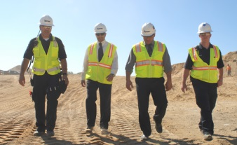
How to Lead by Example
Have a positive attitude about safety
Establish safety as a core value
Set high expectations for safety
Share safety vision with the team
“Walk the talk”
Reinforce the idea that everyone owns safety
Lead up!
Notes:
Leading by example is probably the most important of the safety leadership skills in the
FSL4Res course. Team members learn from their leaders. They notice when they cut corners, don’t follow safety policies or procedures, or give inconsistent safety messages.
The first way to lead by example is to “Walk the talk” – follow safe work procedures and safe practices; practice what you preach in terms of safety; don’t practice the old way of “Do as I say, but not as I do.”
Demonstrate a positive attitude about safety - Use optimistic language when discussing safety with your crew. Praise crew members who come to you with safety concerns.
Establish safety as the team’s core value - Demonstrate that safety is one of your core values by considering the safety implications of every decision you and your crew make. As a safety leader you must set high safety expectations for every team member - Regularly let your crew know that you expect them to always use safe work practices.
Develop and share your safety vision with your team - Consider the safety implications of all your decisions and share those with your team; Talk about the importance of safety for you and your crew and be consistent. Emphasize that safe work goes hand-in-hand with productive, quality work and that injuries will impact their work and home life.
Consistently communicate that everyone owns safety - It’s not just the foreman’s or safety person’s responsibility. It’s up to everyone to keep the jobsite safe for themselves and others.
A final way to lead by example is to lead up by working to persuade individuals like company owners and others in supervisory positions to improve jobsite safety and health.
These actions send the message that safety is an integral part of working every day and not just a way to avoid safety violations.

Slide 12
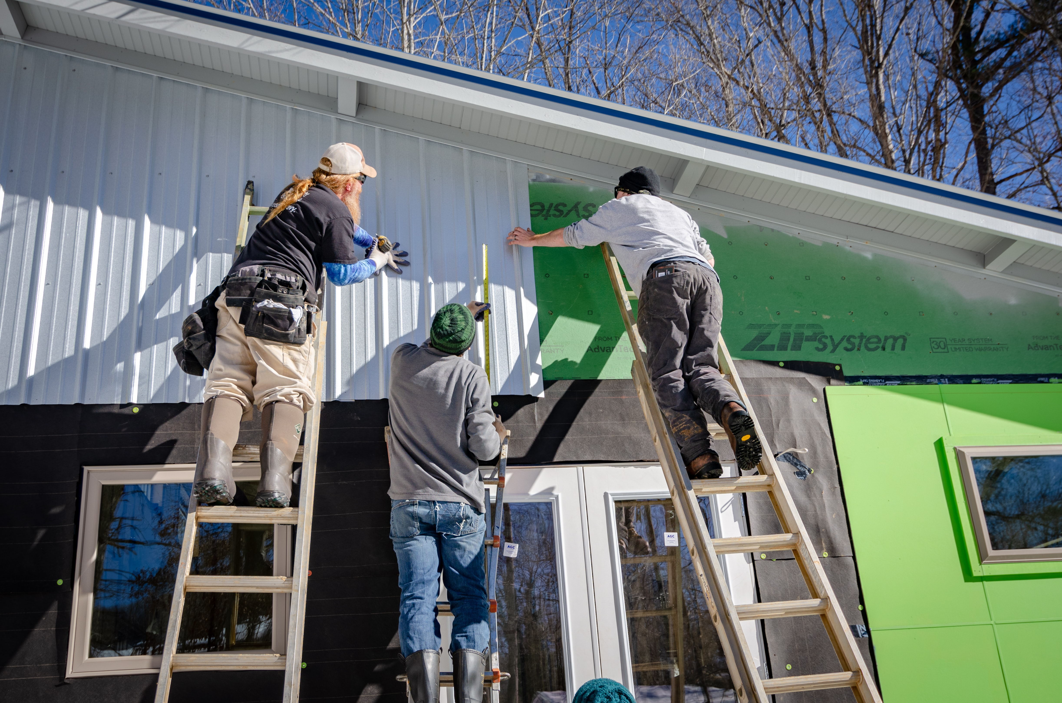
How to
Engage and Empower Team Members
Explain why safety is critical to getting the job done
Engage team members in safety decision-making
Conduct daily morning safety huddles and joint worker-management walk-arounds throughout the workday
Empower team members to
Report safety concerns, injuries, & near misses
Report or fix hazards or unsafe situations
Notes:
The next leadership skill is to engage and empower team members in the safety process.
You can explain why working safely is critical to getting the job done and not just say “be safe.”
You can engage the team in safety-related decisions so they can see how they, too, own safety. These skills can be used with the whole group as well as with individual workers.
Involving workers in daily huddles and joint management walk-arounds lets the team know that safety is valued, it is an essential aspect of how work gets done, and they are a critical part of the overall safety effort.
Finally, as a leader, you need to empower team members to report jobsite hazards, safety concerns, and near misses. Encourage your team to immediately act upon unsafe or hazardous situations by reporting the issue to you. Ask their opinions on how to fix the issue and be open to their suggestions. Make it clear that there will be no negative consequences or retaliation when they report safety concerns, injuries or near misses.
You can develop an “action list” to show how issues raised are addressed and place the list in a prominent place to help ensure accountability and build trust. You can also encourage them to tell you about potential safety issues ahead of time so you can take care of them and prevent injuries before they occur.

Slide 13
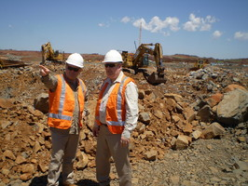
How to Actively listen
Treat team members with respect when they are speaking
Pay attention to non-verbal cues such as body language and eye contact
Listen to hear what is being said vs. to come up with a response.
Ask clarifying questions
Notes:
Being able to communicate effectively is at the core of all the other leadership skills and is critical to becoming an effective safety leader.
Learning to actively listen first involves treating your team member with respect and giving that person your full attention. Don’t check phones, emails, or read other materials during the conversation.
Pay special attention to your and the speaker’s body language because it can sometimes convey more information than words. Maintain eye contact; avoid making negative facial expressions or raising your voice. If you’re feeling resentful or insulted, make an extra effort to maintain professional conduct.
Most importantly, you need to listen to hear what the person is saying rather than listening just to come up with a response.
Finally, ensure you understand what speaker is saying or asking by asking clarifying questions or paraphrasing what the crew member said back to them, so you can ensure you heard them correctly (i.e., “What I hear you saying is….”).

Slide 14
How to Practice 3-way Communication
Make sure you have listener’s attention
Be direct and concise
Ask team member to repeat message
Clarify any misunderstandings
Notes:
This skill outlines a simple strategy you can use to reduce misunderstandings between you and the person you’re speaking with. Practicing 3-way communication helps ensure everyone understands your message or instructions.
Here is how you do this -
First, make sure you have the listener’s attention - Before you start speaking, make sure you have your crew member's undivided attention; be sure that neither of you are preoccupied with phones, computers, or other distractions.
Be direct and concise - Be specific when you give directions or assignments. Avoid giving unrelated information that might lead to confusion.
Ask the listener repeat what you said to be sure the message was understood. - Don’t assume your listener understood what you said. Ask crew members to repeat your message to confirm that they understand what you’re asking. If you feel uncomfortable asking them to repeat the directions, you can say: “Just to be sure we are on the same page, can you tell me exactly what you are going to do?” This is the key to 3-way communication.
Finally, clarify any misunderstandings - If you hear any misunderstanding from the crew, clarify and get final confirmation that everyone is on the same page.

Slide 15
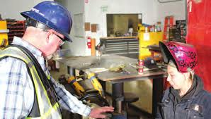
How To Develop Team Members through Teaching, Coaching, and Feedback
Observe worker action
Address the issue
Problem solve
Practice action
Teach & coach
Notes:
Effective safety leaders work to develop their team members by teaching and coaching them on how to do things correctly and safely on the jobsite. They also provide feedback to let them know how they are doing and if any changes are needed.
Teaching = telling;
Coaching = watching;
Feedback = evaluating performance
First, we’ll talk about teaching and coaching.
When you want to teach a team member a new or better way to do something, respectfully ask questions to understand why s/he is doing it that way and then problem-solve together (even if you already have a solution) to find a better or safer approach to completing the task.
Show the team member how to perform the activity correctly, then watch him/her to be sure they have learned how to do it. If they need to be corrected, treat the person with respect and be a coach. Encourage team members to constantly update their knowledge and skills so they can do their jobs better and safer.

Slide 16
How To Develop Team Members through Teaching, Coaching, and Feedback
Use the FIST Principle:
Describe the FACTS
Explain the IMPACT
Provide SUGGESTIONS
Be TIMELY
Notes:
Providing constructive feedback is another leadership skill you can use to develop your team members. When giving constructive feedback, try hard to focus on the situation or behavior rather than the person. The FIST principle can help you do that.
First, describe the Facts: What is the situation or activity/ behavior for which you are providing feedback? When and where did it occur? What were the circumstances?
Then explain the Impact that are the potential consequences that may result (good or bad)?
Then, offer Suggestions: Work together to problem-solve and come up with solutions. Think of ways team members might use the same approach in the future.
Be Timely: Don’t wait to provide feedback. It is more effective when you give it close to when the situation/behavior occurred.

Slide 17
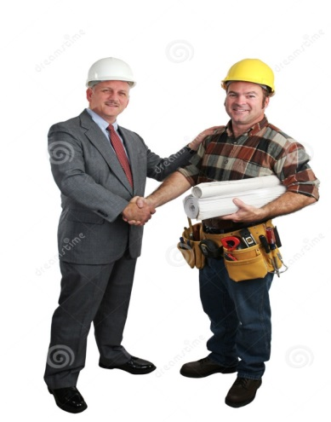
How to Recognize Team Members for a Job Well Done
Give recognition separately from other types of feedback
Regularly give praise in private
Be specific about why you are praising the person
Give praise publically if the person is comfortable with it
Notes:
The final skill effective safety leaders display is recognizing team members when they go above and beyond to maintain a strong positive jobsite safety climate.
When you recognize team members:
Give recognition separately from other types of feedback
Regularly give praise in private
Be specific about why you are praising the person
Give praise publicly if the person is comfortable with it
Appreciation motivates and encourages team members to continue working to maintain and improve the jobsite safety climate. Like other types of feedback, recognition should be given in a timely manner, and it must be sincere. It may be as simple as saying “good job,” giving a hand shake, or saying “thank you” for going the extra mile for safety or for something really well done.
It’s important to know your team members as individuals so you can use praise and acknowledgement effectively. For those who are comfortable with public praise, it is a great way to show others that safety is valued. However, a person uncomfortable with public praise may be more embarrassed rather than pleased. There are generational differences, as well as differences between individuals. Some workers like to feel valued and appreciated while others feel uncomfortable with praise in public. Think about personality of individuals and jobsite culture or climate. Be careful to consider any perceived preferential treatment.

Slide 18
How often do you … | Always | Sometimes | Never
1. Lead by example
Maintain a positive attitude about safety | r | r | r
Consider the safety implications of all your decisions | r | r | r
Set high expectations for team members | r | r | r
Walk the talk – always follow safe work practices | r | r | r
Communicate with your team that everyone owns safety | r | r | r
2. Engage and empower team members
Engage team members in daily safety meetings or morning safety huddles | r | r | r
Request input from team members about safety | r | r | r
Encourage team members to identify and report safety issues such as hazards, concerns, injuries, and near misses | r | r | r
3. Actively listen
Treat team members with respect when communicating with them | r | r | r
Actively listen to hear what is said vs. coming up with a response | r | r | r
Pay attention to non-verbal cues and ask clarifying questions | r | r | r
4. Practice 3-way communication
Be direct and concise, and make sure you have your listener’s attention | r | r | r
Ask team member to repeat message/ instructions, and clarify misunderstandings | r | r | r
5. Develop Team Members Through Teaching, Coaching, and Feedback
Teach and coach members in a respectful manner | r | r | r
Focus on the problem rather than judging the person when you give feedback | r | r | r
Make sure team members know how to do a new task before actually doing it | r | r | r
6. Recognize Team Members for a Job Well Done
Say “good job” or “thank you” to team members who go above and beyond to create a safe jobsite | r | r | r
Use positive recognition of team members to encourage jobsite safety | r | r | r
Self-Assessment
Notes:
[Pass out self-assessment worksheet]
This worksheet will give you an idea of how often you already use the leadership skills and which ones are new to you. Please complete the worksheet and bring it to Session 2 so we can discuss how often you use the skills on the jobsite.

Slide 19
Takeaways
It takes COURAGE to be a leader
It takes COURAGE to speak up
These skills can easily be inserted into the daily workflow and productivity will not be effected.
Leaders…
Lead by example
Engage and empower team member
Actively listen
Practice 3-way communication
Develop team members by teaching, coaching, and knowing how to give constructive feedback
Recognize team members
Leaders improve SAFETY CLIMATE AND SAFETY OUTCOMES
Notes:
We’ve come to the end of the first session, and we’ve covered a lot.
Before we uncover the take away messages, tell me one or two things you learned today, or even better, something you’re going to start or maybe stop doing when you get back to the jobsite.
So, here are the key points I hope you will take away with you and put into practice on the jobsite:
It takes courage to be a leader and speak up.
You can use these skills on a daily basis without affecting workflow and productivity
Leaders…
Lead by example
Engage and empower team members
Actively listen
Practice 3-way communication
Develop team members by teaching, coaching, and knowing how to give constructive feedback
Recognize team members for going above and beyond for safety
And finally, if you use these skills on the jobsite and become a true safety leader, you can improve both jobsite safety climate and safety outcomes.

Slide 20
You have now completed Session 1
Development of the FSL4Res training was supported with funding from a cooperative agreement to CPWR - The Center for Construction Research and Training (#U60OH009762) from the National Institute for Occupational Safety and Health (NIOSH) The FSL4Res is based on the original FSL training created by CPWR under an earlier NIOSH cooperative agreement (#OH009762) The contents are solely the responsibility of the authors and do not necessarily represent the official views of NIOSH. All Rights Reserved.
Notes:
This ends session 1.
Please remember to complete your self-assessment and bring it with you to session 2.

